Slide 1
Precipitation method
This method can be used to determine the
chloride ion concentration of water samples from many
sources such as, stream water, river water and many
drugs and chemicals.

Slide 2
Introduction
This method determines the chloride ion concentration of a solution by titration with silver nitrate. As the silver nitrate solution is slowly added, a precipitate of silver chloride forms.
Ag+(aq) + Cl–(aq) → AgCl(s)
The end point of the titration occurs when all the chloride ions are precipitated. Then additional silver ions react with the chromate ions of the indicator, potassium chromate, to form a red-brown precipitate of silver chromate.
2 Ag+(aq) + CrO42–(aq) → Ag2CrO4(s)

Slide 3
Solutions Needed
Silver nitrate solution-AgNO3
Potassium chromate
Sample water
Standard sodium chloride

Slide 4
Equipment Needed
Burette and stand
10 and 20 mL pipettes
100 mL volumetric flask
250 mL conical flasks
10 mL and 100 mL measuring cylinders

Slide 5
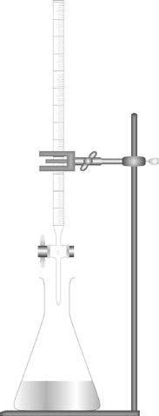

Slide 6
Ex. No: 2
Estimation of amount of Chloride content of a water sample
S.No | Content | Titration – I Standardization of AgNO3 | Titration – II Estimation of Chloride
1 | Burette Solution | AgNO3 | Std. AgNO3
2 | Pipette Solution | Standard Sodium Chloride (20 ml) | Sample water (20 ml)
3 | Additional Solution | Nil | Nil
4 | Indicator | Potassium Chromate (1 ml) | Potassium Chromate (1 ml)
5 | Endpoint | Yellow Color to reddish brown color | Yellow Color to reddish brown color

Slide 7
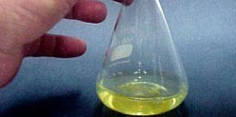
Figure 1 Before the addition of any silver nitrate the chromate indicator gives the clear solution a lemon-yellow colour.

Slide 8
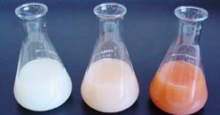
Figure 2 Left flask: before the titration endpoint, addition of Ag+ ions leads to formation of silver chloride precipitate, making the solution cloudy. The chromate indicator gives a faint lemon- yellow colour. Centre flask: at the endpoint, all the Cl− ions have precipitated. The slightest excess of Ag+ precipitates with the chromate indicator giving a slight red-brown colouration. Right flask: If addition of Ag+ is continued past the endpoint, further silver chromate precipitate is formed and a stronger red-brown colour results. NB: The titration should be stopped when the first trace of red-brown colour is observed.

